Slide 1
UPPER SIXTH ARTS
GEOGRAPHY
Lesson 13: Migration: Characteristics, Laws and Models
Migration: Characteristics, Laws and Models
Notes:
Good morning, class, and welcome to our geography lesson. I am your geography teacher, Mr Kamdem. Today we are starting Lesson 13: Migration: Characteristics, Laws and Models.

Slide 2
CLASS INFO
Class, Chapter and Duration
Class | Upper Sixth Arts
Chapter | Module 4: Understanding and managing population dynamics across the world in general and Cameroon in particular
Duration | 2 periods (2 × 50 minutes)
Notes:
This lesson is for Upper Sixth Arts. It belongs to Module 4: Understanding and managing population dynamics across the world in general and Cameroon in particular. We shall need 2 periods to cover it.

Slide 3
IDENTIFICATION
Lesson Identification
Topic | Population Change over Space (Migration)
Sub-topic | Migration Laws
Lesson | Lesson 13: Migration: Characteristics, Laws and Models
Notions / Concepts | Migration, volume, differentials, Zipf's inverse distance law, gravity model, Stouffer's intervening opportunities.
Syllabus focus | Meaning; characteristics and differentials (volume); Zipf, gravity and Stouffer models; calculations.
Competence | Learners are able to explain migration with laws and models and carry out simple calculations.
Notes:
Our topic is Population Change over Space (Migration), and the sub-topic is Migration Laws. The key notions we shall use today are: migration, volume, differentials, Zipf's inverse distance law, gravity model, Stouffer's intervening opportunities. At the end, you should be able to do this: learners are able to explain migration with laws and models and carry out simple calculations.

Slide 4

HOMEWORK CORRECTION
Correction of the Homework
Question (Lesson 12: The Demographic Transition Model):
Draw the DTM and place Niger, Cameroon, France and Japan on it.
Notes:
Before we start the new lesson, let us correct the homework I gave you at the end of Lesson 12: The Demographic Transition Model. The question was: Draw the DTM and place Niger, Cameroon, France and Japan on it. Take out your exercise books.

Slide 5
HOMEWORK CORRECTION
Correction: Possible Answer
Niger – stage 2 (high births, falling deaths); Cameroon – late stage 2/early stage 3; France – stage 4; Japan – stage 5 (declining).
Notes:
Here is a good answer. Niger – stage 2 (high births, falling deaths); Cameroon – late stage 2/early stage 3; France – stage 4; Japan – stage 5 (declining). Compare it with your own answer and correct your work in red.

Slide 6
LESSON PLAN
Lesson Plan
Correction of the homework
Objectives and recall
Real-life situation and action to take
Learning activities
Board summary
Evaluation, remediation and homework
Notes:
Here is the plan of our lesson today. First, we shall correct the homework. Then we shall look at the objectives and recall what you already know. After that, we shall study a situation from real life and the action to take, and do the learning activities. Finally, we shall copy the board summary, do the evaluation and the remediation, and I will give you the homework.

Slide 7
OBJECTIVES
Objectives
By the end of this lesson, you should be able to:
Define migration and its characteristics.
Explain Zipf's law, the gravity model and Stouffer's model.
Notes:
Take your time to copy this part; we will continue together.

Slide 8
OBJECTIVES
Objectives (continued)
Calculate interaction with the gravity model.
Notes:
By the end of this lesson, you should be able to do three things. Number 1: define migration and its characteristics. Number 2: explain Zipf's law, the gravity model and Stouffer's model. Number 3: calculate interaction with the gravity model.

Slide 9
PREVIOUS KNOWLEDGE
Previous Knowledge
Migration changes population distribution.
People move from villages to towns.
Notes:
Let us first remember what you already know. Migration changes population distribution. People move from villages to towns. Keep this in mind, because we shall build on it today.

Slide 10
REAL-LIFE SITUATION
Situation in Real Life
Most migrants to Douala come from the nearby West and Littoral, fewer from the far North. But many northerners stop in Garoua or Ngaoundéré instead of going to Douala.
Notes:
Listen carefully to this situation from real life. Most migrants to Douala come from the nearby West and Littoral, fewer from the far North. But many northerners stop in Garoua or Ngaoundéré instead of going to Douala. Think about it, because I am going to ask you some questions.

Slide 11
REAL-LIFE SITUATION
Situation: Question 1
What is the problem in the situation?
Notes:
Question 1: What is the problem in the situation? Think for a moment, then raise your hand to answer.

Slide 12
REAL-LIFE SITUATION
Answer
Migrants do not all go to the biggest city.
Notes:
Good. Migrants do not all go to the biggest city.

Slide 13
REAL-LIFE SITUATION
Situation: Question 2
How does distance affect migration?
Notes:
Question 2: How does distance affect migration? Think for a moment, then raise your hand to answer.

Slide 14
REAL-LIFE SITUATION
Answer
Fewer people migrate over long distances.
Notes:
Good. Fewer people migrate over long distances.

Slide 15
REAL-LIFE SITUATION
Situation: Question 3
Why do northerners stop in Garoua?
Notes:
Question 3: Why do northerners stop in Garoua? Think for a moment, then raise your hand to answer.

Slide 16
REAL-LIFE SITUATION
Possible Answer
It offers opportunities nearer home (intervening opportunity).
Notes:
Good. It offers opportunities nearer home (intervening opportunity).

Slide 17
ACTION TO TAKE
Action to Take
Explain migration flows using laws and models.
Notes:
From this situation, the action we are working towards in this lesson is the following: explain migration flows using laws and models.

Slide 18
JUSTIFICATION
Justification of the Lesson
This lesson helps us to explain and predict the flows of migrants.
Notes:
Why is this lesson important for you? This lesson helps us to explain and predict the flows of migrants.

Slide 19

1. MEANING AND CHARACTERISTICS
Activity 1
Travellers at a bus station.
Notes:
Activity 1. Look carefully at this picture: travellers at a bus station. Observe every detail before I ask the question.

Slide 20
1. MEANING AND CHARACTERISTICS
Activity 1: Question
What is migration? Is a daily trip to school migration?
Notes:
Here is the question for Activity 1: What is migration? Is a daily trip to school migration? Take one minute to think and write your answer in your rough notebook.

Slide 21
1. MEANING AND CHARACTERISTICS
Activity 1: Answer
A change of residence; no, a daily trip is not migration.
Notes:
Let us check the answer together. A change of residence; no, a daily trip is not migration.

Slide 22
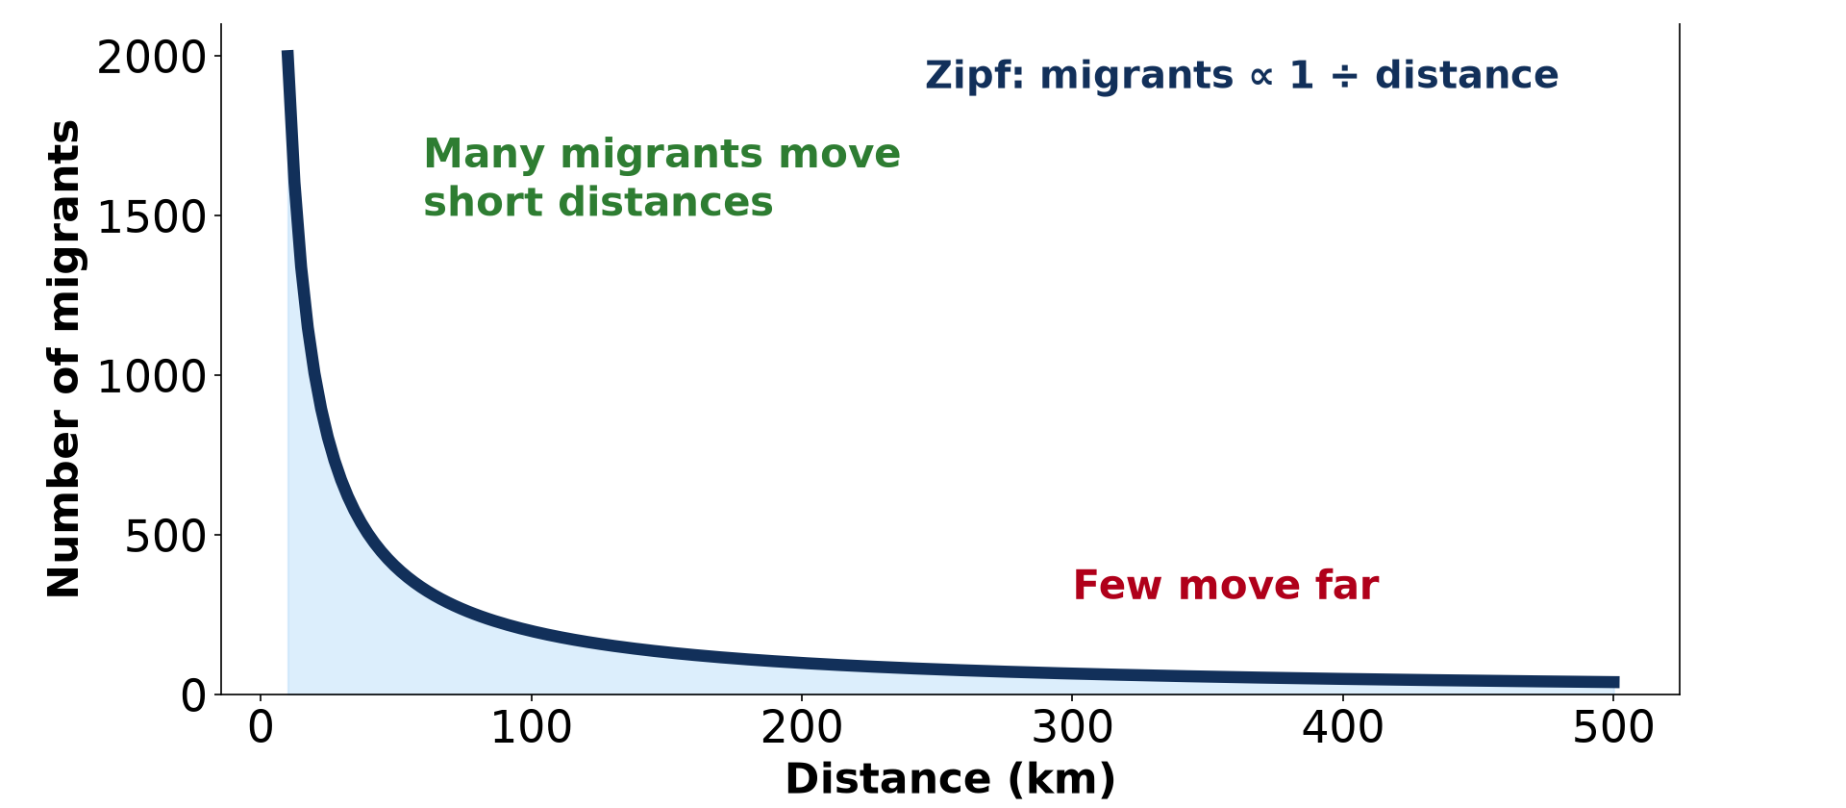
2. ZIPF'S INVERSE DISTANCE LAW
Activity 2
Migrants decrease with distance.
Notes:
Activity 2. Look carefully at this diagram: migrants decrease with distance. Observe every detail before I ask the question.

Slide 23
2. ZIPF'S INVERSE DISTANCE LAW
Activity 2: Question
What does Zipf's inverse distance law say?
Notes:
Here is the question for Activity 2: What does Zipf's inverse distance law say? Take one minute to think and write your answer in your rough notebook.

Slide 24
2. ZIPF'S INVERSE DISTANCE LAW
Activity 2: Answer
The number of migrants falls as distance increases.
Notes:
Let us check the answer together. The number of migrants falls as distance increases.

Slide 25
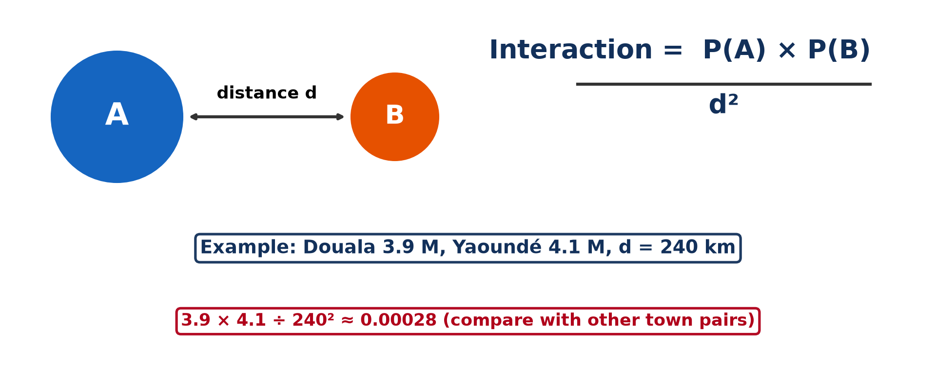
2. THE GRAVITY MODEL
Activity 3
The gravity model.
Notes:
Activity 3. Look carefully at this diagram: the gravity model. Observe every detail before I ask the question.

Slide 26
2. THE GRAVITY MODEL
Activity 3: Question
What two things increase interaction between towns?
Notes:
Here is the question for Activity 3: What two things increase interaction between towns? Take one minute to think and write your answer in your rough notebook.

Slide 27
2. THE GRAVITY MODEL
Activity 3: Answer
Larger populations and shorter distance.
Notes:
Let us check the answer together. Larger populations and shorter distance.

Slide 28
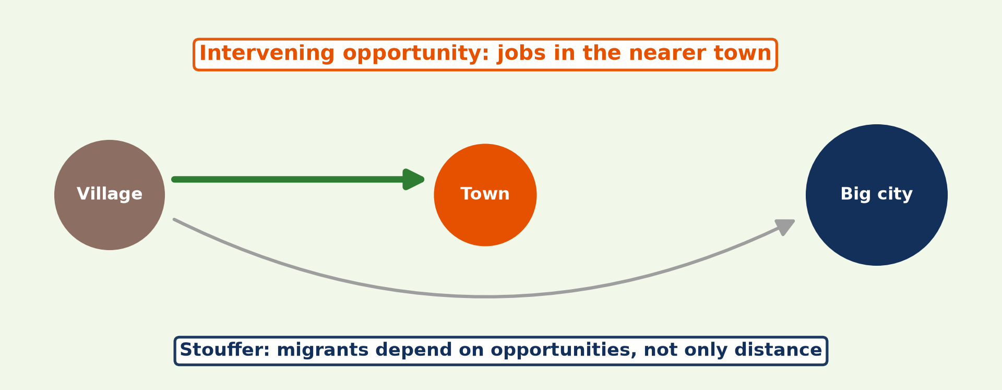
2. STOUFFER'S MODEL
Activity 4
Intervening opportunities.
Notes:
Activity 4. Look carefully at this diagram: intervening opportunities. Observe every detail before I ask the question.

Slide 29
2. STOUFFER'S MODEL
Activity 4: Question
Why do some migrants stop before reaching the big city?
Notes:
Here is the question for Activity 4: Why do some migrants stop before reaching the big city? Take one minute to think and write your answer in your rough notebook.

Slide 30
2. STOUFFER'S MODEL
Activity 4: Answer
They find jobs or opportunities in a nearer town.
Notes:
Let us check the answer together. They find jobs or opportunities in a nearer town.

Slide 31

3. CALCULATIONS
Activity 5
Cameroon population by region.
Notes:
Activity 5. Look carefully at this diagram: cameroon population by region. Observe every detail before I ask the question.

Slide 32
3. CALCULATIONS
Activity 5: Question
Town A has 100,000 people, town B 400,000, distance 200 km. Calculate the interaction.
Notes:
Here is the question for Activity 5: Town A has 100,000 people, town B 400,000, distance 200 km. Calculate the interaction. Take one minute to think and write your answer in your rough notebook.

Slide 33
3. CALCULATIONS
Activity 5: Answer
100,000 × 400,000 ÷ 200² = 1,000,000 (a relative index).
Notes:
Let us check the answer together. 100,000 × 400,000 ÷ 200² = 1,000,000 (a relative index).

Slide 34
BOARD SUMMARY
Board Summary
Topic: Population Change over Space (Migration)
Sub-topic: Migration Laws
Lesson 13: Migration: Characteristics, Laws and Models
Notes:
Now we are going to copy the board summary. Write the title and the headings neatly in your notebooks. I will give you enough time for each slide, so do not rush.

Slide 35
BOARD SUMMARY
1. Meaning and Characteristics of Migration
Migration can be understood as follows:
Migration: It is the movement of people from one place to another to live there for a long time, usually more than a year. Daily trips to school are circulation, not migration.
Notes:
Let us copy Meaning and Characteristics of Migration. Migration can be understood as follows. On this slide we have Migration. Write each point on a new line, with the key term first, and explain it in your own words when we revise. When you finish, we go to the next slide.

Slide 36
BOARD SUMMARY
1. Meaning and Characteristics of Migration (continued)
Migration differentials: Migrants are often young adults, males in the first stages, and more educated than those who stay. The volume of migration varies with distance, opportunities and obstacles.
Notes:
We continue with Meaning and Characteristics of Migration. On this slide we have Migration differentials. Write each point on a new line, with the key term first, and explain it in your own words when we revise.

Slide 37
BOARD SUMMARY
2. Laws and Theories of Migration
Migration is explained by the following laws and models:
Zipf's inverse distance law: The number of migrants decreases as distance increases. Most people move over short distances.
Notes:
Let us copy Laws and Theories of Migration. Migration is explained by the following laws and models. On this slide we have Zipf's inverse distance law. Write each point on a new line, with the key term first, and explain it in your own words when we revise. When you finish, we go to the next slide.

Slide 38
BOARD SUMMARY
2. Laws and Theories of Migration (continued)
The gravity model: Interaction between two towns is proportional to the product of their populations divided by the square of the distance. Large, close towns interact most.
Notes:
We continue with Laws and Theories of Migration. On this slide we have The gravity model. Write each point on a new line, with the key term first, and explain it in your own words when we revise. When you finish, we go to the next slide.

Slide 39
BOARD SUMMARY
2. Laws and Theories of Migration (continued)
Stouffer's intervening opportunities: Migration depends on the opportunities between origin and destination, not only on distance. Migrants may stop at a closer town that offers jobs.
Notes:
We continue with Laws and Theories of Migration. On this slide we have Stouffer's intervening opportunities. Write each point on a new line, with the key term first, and explain it in your own words when we revise.

Slide 40
BOARD SUMMARY
2. Laws and Theories of Migration
Illustration: the gravity model
Notes:
Now draw this illustration in your notebook: the gravity model. Give it a title and label it clearly.

Slide 41
BOARD SUMMARY
3. Calculations Based on Models
The gravity model is calculated as follows:
Formula: I = (P1 × P2) ÷ d². P1 and P2 are the populations and d the distance.
Example: Town A 100,000, town B 400,000, distance 200 km: I = (100,000 × 400,000) ÷ 40,000 = 1,000,000. The value is compared with other pairs of towns.
Notes:
Let us copy Calculations Based on Models. The gravity model is calculated as follows. On this slide we have Formula and Example. Write each point on a new line, with the key term first, and explain it in your own words when we revise.

Slide 42
FORMATIVE EVALUATION
Evaluation 1
State Zipf's inverse distance law.
Notes:
Now let us check what you have understood. Question 1: State Zipf's inverse distance law. Answer in your exercise book.

Slide 43
FORMATIVE EVALUATION
Expected Answer
The number of migrants falls as distance increases.
Notes:
The expected answer is: the number of migrants falls as distance increases. If you got it right, well done.

Slide 44
FORMATIVE EVALUATION
Evaluation 2
Town A 50,000, town B 200,000, distance 100 km. Find the gravity index.
Notes:
Now let us check what you have understood. Question 2: Town A 50,000, town B 200,000, distance 100 km. Find the gravity index. Answer in your exercise book.

Slide 45
FORMATIVE EVALUATION
Expected Answer
50,000 × 200,000 ÷ 100² = 1,000,000.
Notes:
The expected answer is: 50,000 × 200,000 ÷ 100² = 1,000,000. If you got it right, well done.

Slide 46
REMEDIATION
Remediation
Fill in the blanks:
A change of residence is ______.
Interaction falls with the ______ of distance.
A nearer opportunity is an ______ opportunity.
Notes:
For those who need more practice, fill in the blanks in your exercise book. The answers are: number 1, migration; number 2, square; number 3, intervening.

Slide 47
HOMEWORK
Homework
Use the gravity model to compare Douala–Yaoundé and Douala–Garoua.
Notes:
For your homework: Use the gravity model to compare Douala–Yaoundé and Douala–Garoua. We shall correct it at the beginning of our next lesson.

Slide 48
NEXT LESSON
Next Lesson
Our next lesson will be on:
Lesson 14: Spatial Interaction
Notes:
Our next lesson will be on Lesson 14: Spatial Interaction. Thank you for your attention, and see you next time.

Slide 49
BILINGUAL GAME
Bilingual Game (Jeu Bilingue)
English | Français
Migration | La migration
Distance | La distance
Flow | Le flux
Model | Le modèle
Opportunity | L'opportunité
Residence | La résidence
Notes:
Let us play the bilingual game. I say a word in English, and you give me the French word. Then we do the reverse.

Slide 50
LOGBOOK
Official Logbook (1/2)
Module / Topic | Population Change over Space (Migration)
Lesson Title | Lesson 13: Migration: Characteristics, Laws and Models
Expected Learning Outcomes | Define migration and its characteristics. Explain Zipf's law, the gravity model and Stouffer's model. Calculate interaction with the gravity model.
Competence | Learners are able to explain migration with laws and models and carry out simple calculations.
Notes:
I record this information in the official logbook of the class after the lesson.

Slide 51
LOGBOOK
Official Logbook (2/2)
Matter Taught | Meaning and Characteristics of Migration; Laws and Theories of Migration; Calculations Based on Models.
Evaluation | Formative evaluation and remediation exercise.
Homework | Use the gravity model to compare Douala–Yaoundé and Douala–Garoua.
Enrolment / Present / Absent | ____ / ____ / ____
Achievement | To be completed after the lesson.
Notes:
I complete the second page of the logbook: the matter taught, the evaluation, the homework and the attendance.

Slide 52
TEACHER'S NOTE
Teacher's Note
Timing: Homework correction, plan, objectives 8 min | Recall, situation, action 10 min | 5 activities 30 min | Board summary (copying) 30 min | Evaluation, remediation 10 min | Homework, next lesson 5 min | Logbook 7 min
Without the projector (Activity 1): define migration.
Without the projector (Activity 2): draw the curve.
Without the projector (Activity 3): do the calculation.
Without the projector (Activity 4): give examples from Cameroon.
Without the projector (Activity 5): do the calculation.
Notes:
This slide is for me, the teacher: it gives the timing of the lesson and what to do if the projector is not available.

Slide 53
REFERENCES
References
National Geography Syllabus, MINESEC/IGE/IP-SS, 2019 — Module 4 (Population Geography).
Photo, Activity 1: “Wadi Halfa Bus Station” by D-Stanley, CC BY 2.0, via Flickr (https://www.flickr.com/photos/79721788@N00/8651154444)
Diagrams and animations: drawn for this lesson (Geography Department).
Notes:
These are the references and picture credits used to prepare this lesson.

